Slide 1

The Energy Hub

Slide 2

IACSD Akurdi, Pune

Slide 3
Group No:G60
Guided By:
Mr. Kashinath Patil
Presented By:
Shruti Jagtap (210541281187)
Reshma Jagade (210541281069)

Slide 4
Abstract
In this modern world, computer becomes more and more popular and important to our society. We can use computer everywhere and they are very useful and helpful to our daily life.
This project is designed to facilitate a gymming and fitness center to automate its operations of keeping records and store them in form of a large and user friendly database further facilitating easy access to the personnel.

Slide 5
ADMIN MODULES
Member Record
Trainer Record
Package Record
Batch Record

Slide 6
TRAINER MODULES
Trainer Record
Batch Record

Slide 7
MEMBER MODULES
Member Record
Package Record

Slide 8
SCOPE & PURPOSE
Purpose:
The proposed system The Energy Hub , web application was developed as a gym management system . The application, which helps for managing gym data .It is an open source application, it was developed to run on any browser which is running on any operating system

Slide 9
Scope:
This project is helpful in the Automation of gym record including gym batches, packages, membership and gym Management System also the software is going to provide a huge amount of summary data.

Slide 10
Hardware & Software specification
Software Requirements:
Technology: J2EE
IDE: STS
Client Side Technology: JSP, CSS, Bootstrap
Server side Technology: Java
Data Base Server: MYSQL
Operating system: Windows/Linux

Slide 11
Hardware & Software specification
Hardware Requirements:
Processor: Pentium-III or higher.
Ram:64MB or higher.
Hard Disk:80GB or higher

Slide 12
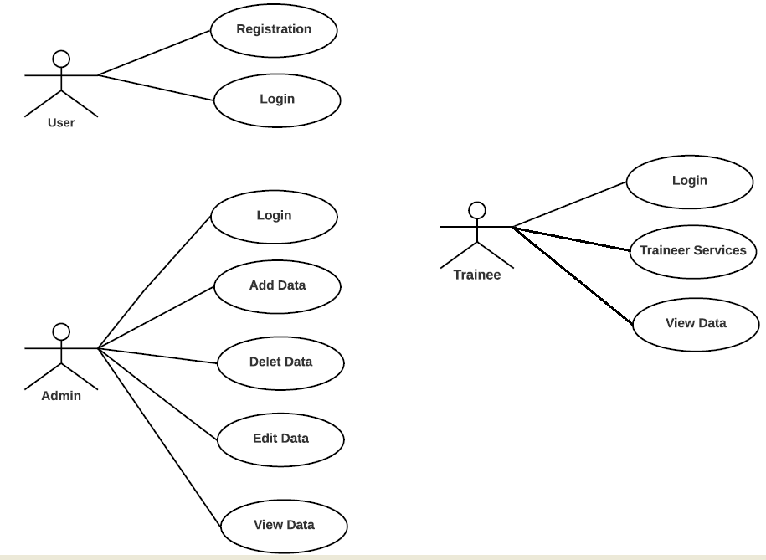
Use case diagram

Slide 13
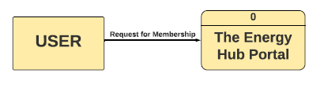
DFD(Data flow Diagram)
DFD-Level 0:

Slide 14
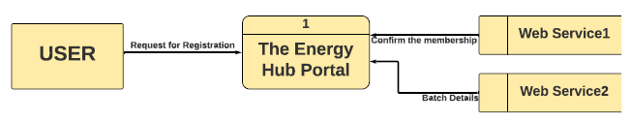
DFD-Level 1

Slide 15

DFD-Level 2

Slide 16
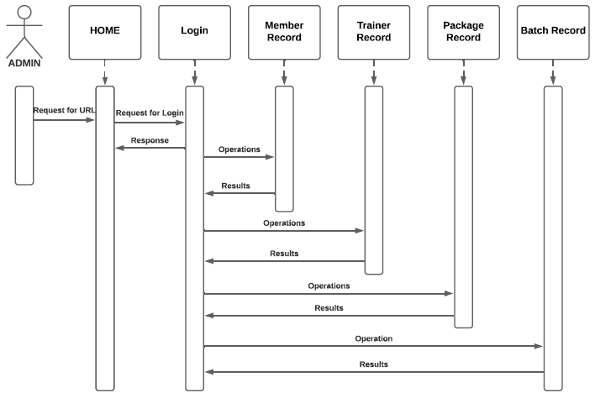
1.Admin sequence diagram:

Slide 17
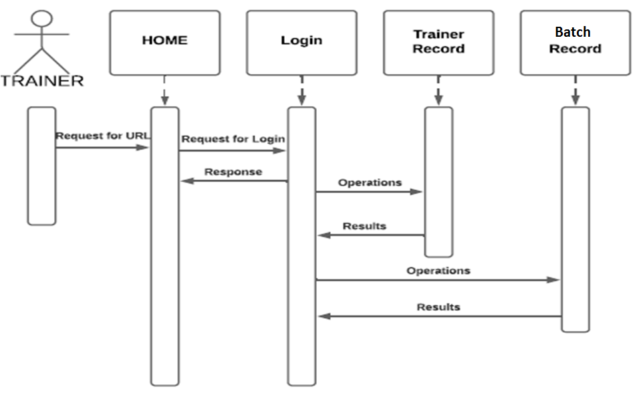
2.Trainer sequence diagram:

Slide 18
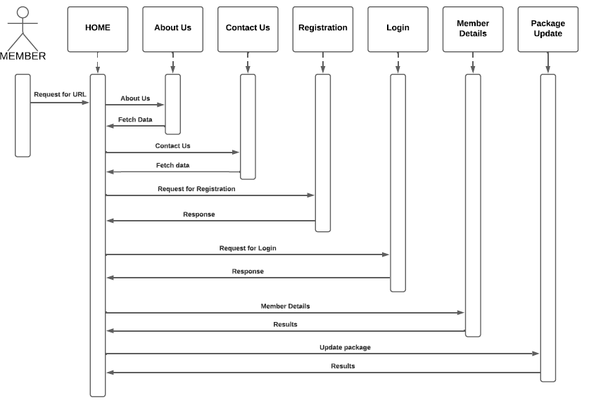
3.Member sequence diagram:

Slide 19
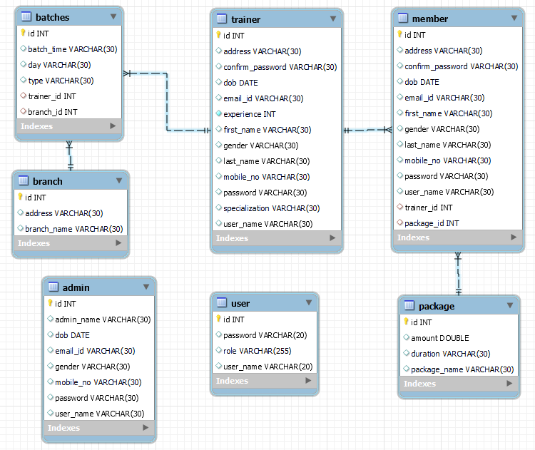
E-R Diagram

Slide 20

Screenshots:

Slide 21
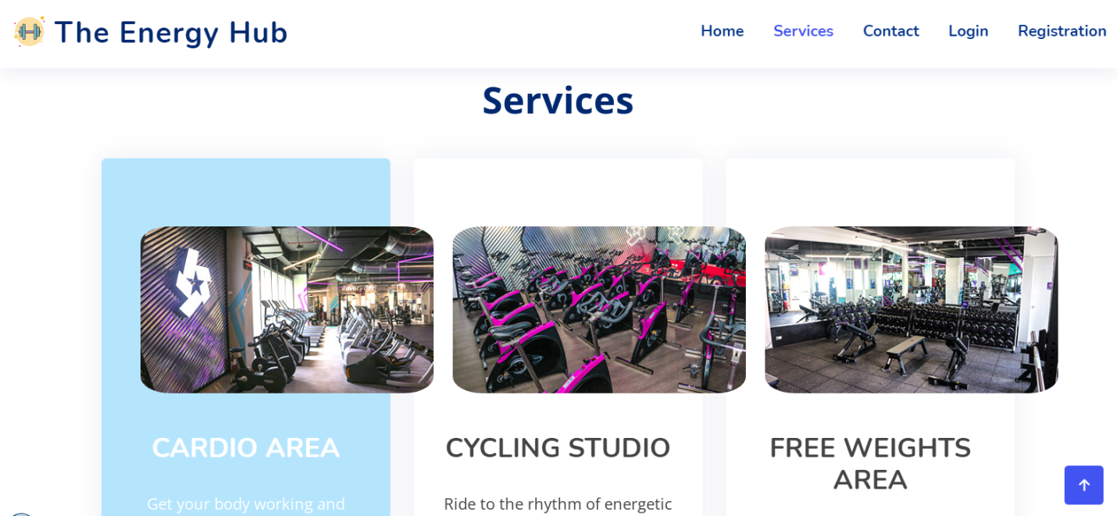

Slide 22
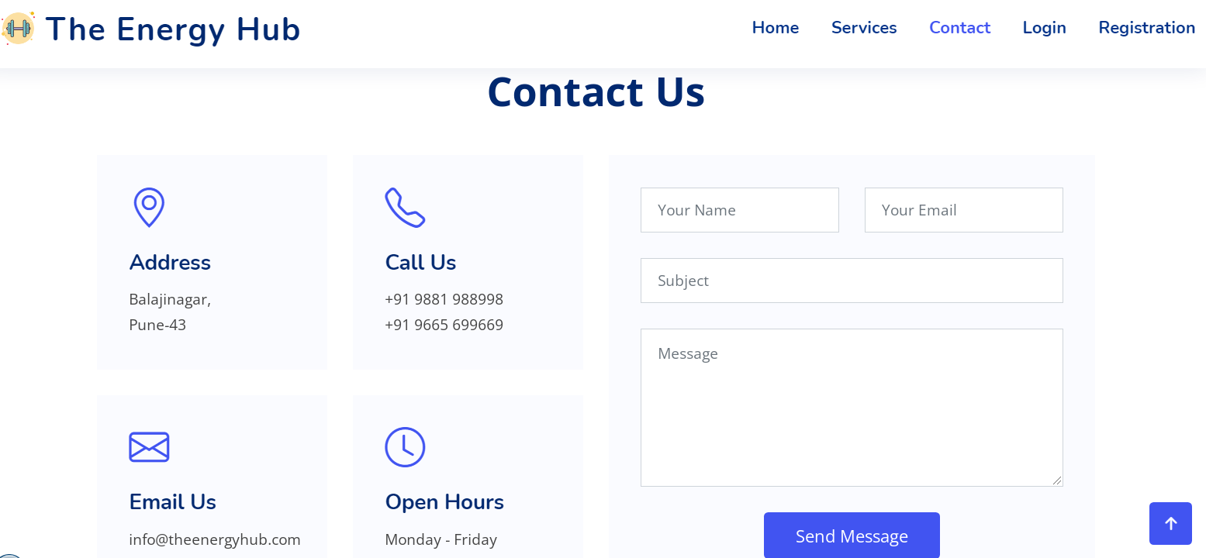

Slide 23
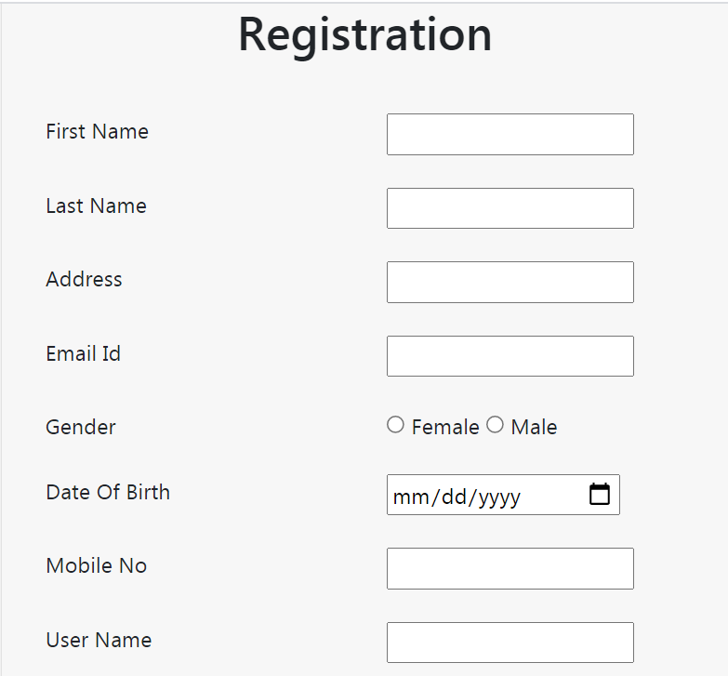
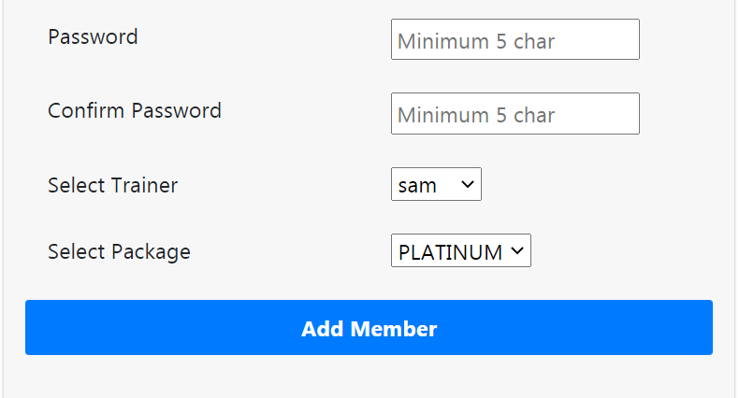

Slide 24
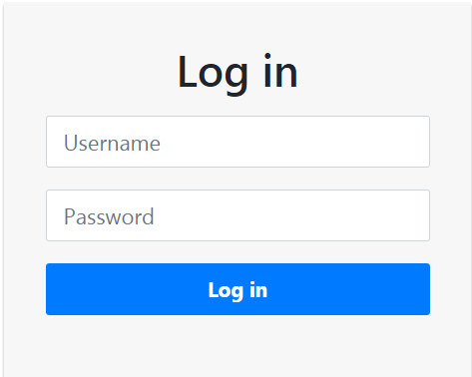

Slide 25
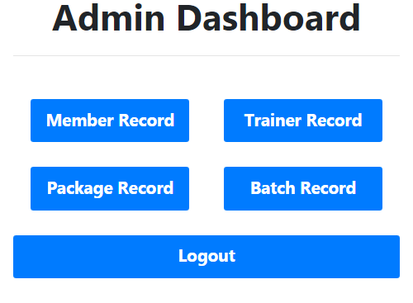

Slide 26
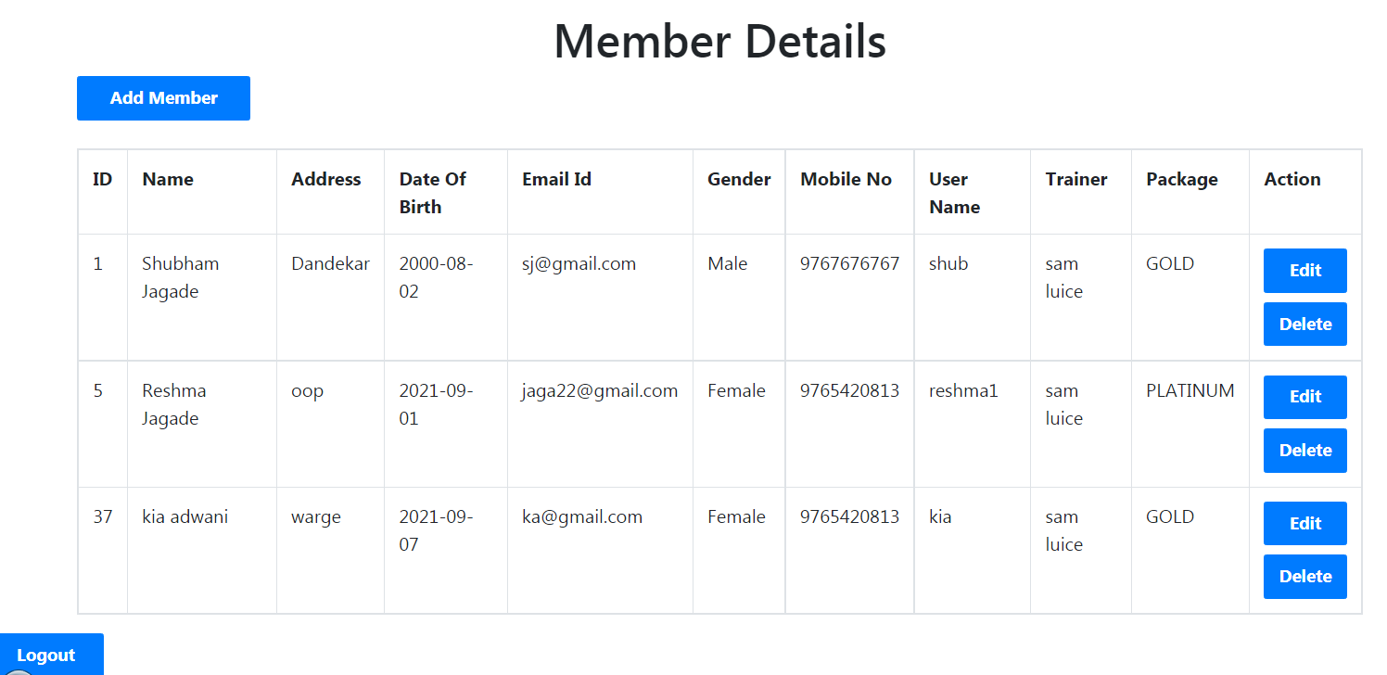

Slide 27
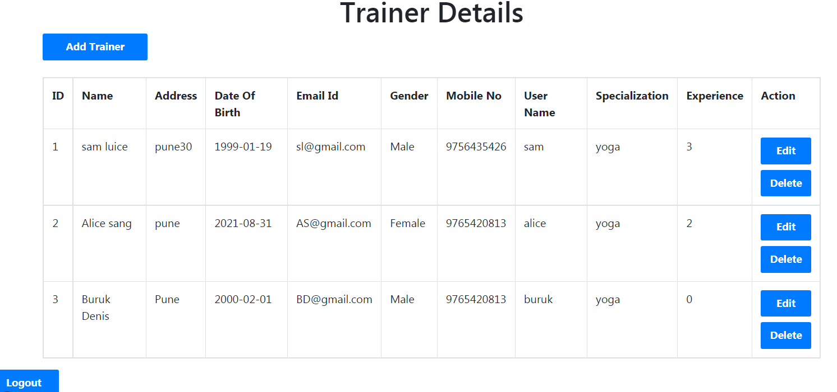

Slide 28
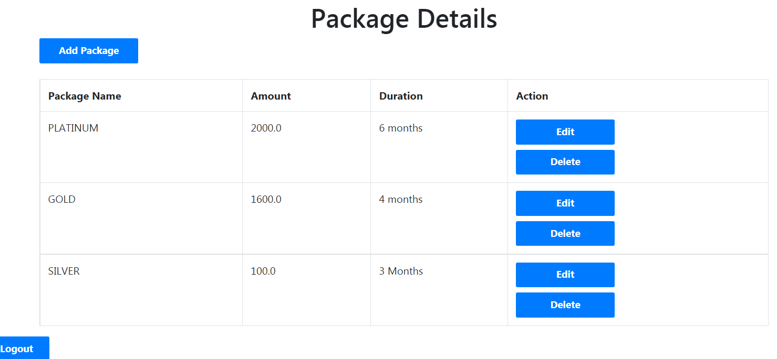

Slide 29
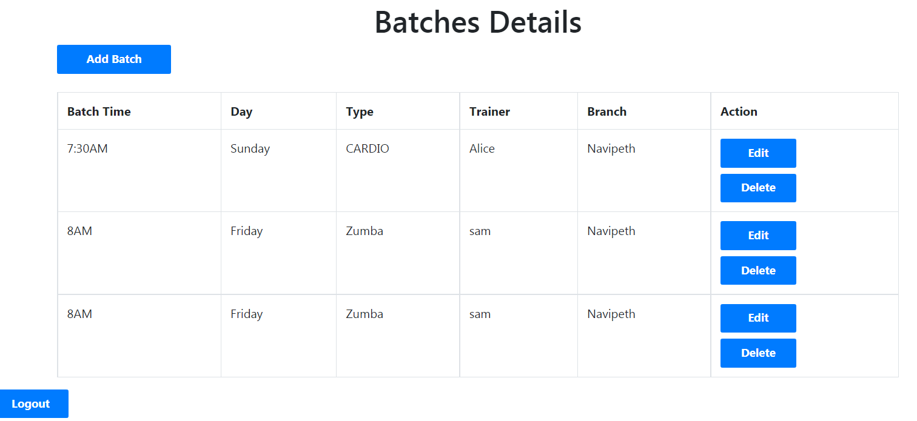

Slide 30
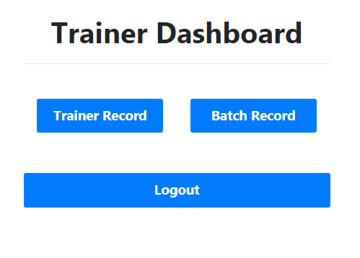

Slide 31
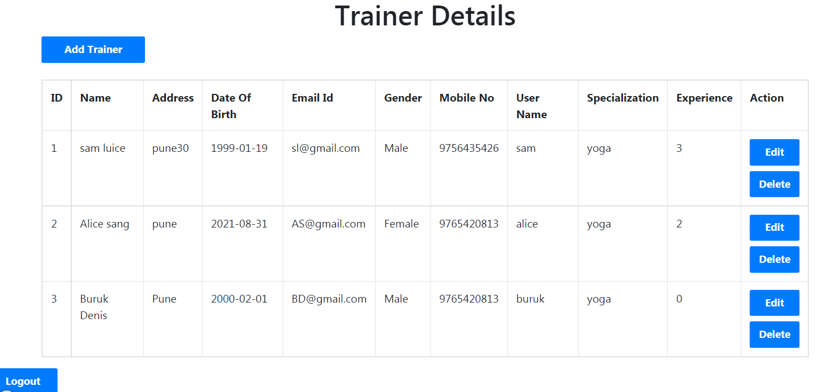

Slide 32
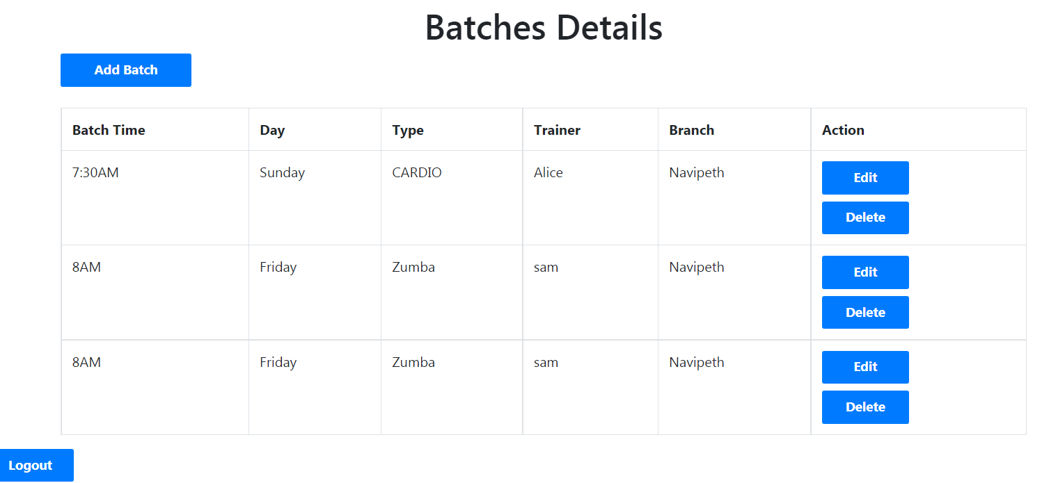

Slide 33


Slide 34
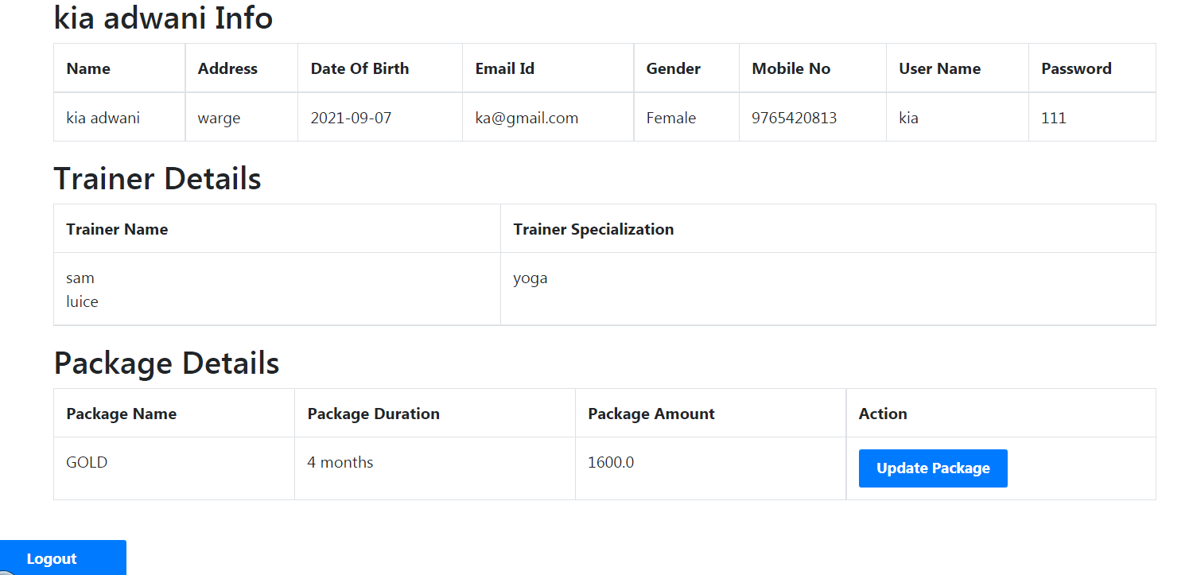

Slide 35
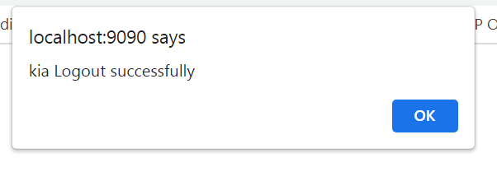

Slide 36
Future Scope & Conclusion
Future Scope:
This web application involves almost all recording features. The future implementation will be online help for the customer and chatting with website administrator
Also we can arrange the online gym sessions for members.

Slide 37
Conclusion:
The project entitled “The Energy Hub”
is developed using JSP, CSS, Bootstrap as front end and JAVA, MYSQL database in back end to computerize the process of gym management. This project covers all storageing features required.

Slide 38
BIBLIOGRAPHY
WEB REFERENCES:
Fitness Gym
www.wikipedia.com
www.tutorialspoint.com
https://www.apachefriends.org/download.html
https://jquery.com
https://howtodoinjava.com/hibernate/hibernate-one-to-many-mapping-using-annotations/
https://www.journaldev.com/3524/spring-hibernate-integration-example-tutorial

Slide 39
REFERENCE BOOKS:
J2EE: The complete Reference
HTML & CSS: The Complete Reference, Fifth Edition

Slide 40
THANK YOU!!!

